Slide 1
Keylogger
Project by: Dan Sutter, Lauren Potersnak

Slide 2
Purpose
Implement a keylogger
This is a mechanism that stores users keystrokes to a file
The key logger also stores what application the user is accessing at the moment
Keylogger periodically screenshots victim’s screen
Key logger periodically email the attacker the contents of the file
Inform how to protect your computer against similar keyloggers

Slide 3
Malicious use of keyloggers
Secretly capture and record sensitive data through keyboard strokes
Email data
Login credentials
Websites browsed
Financial information
Cybercriminals can use this to
Commit financial fraud
Identity theft
Steal sensitive information

Slide 4


KeyLogger Implementation
Technology used
Python language version 3.9
Pynput library
Windows OS
Our Files
Key_logger.pyw
Pyw – so that the user will not be notified of its activation
To stop logger user must disable in task manager
Launch.bat
Code to start the keylogger if the user selects another application

Slide 5

Launch.bat
1: starts the file
2:Starts the keylogger in the specified location
3: starts the regular Internet Explorer program
By changing the Launch options of IE whenever the user clicks on the supplication the keylogger will also be launched

Slide 6
Key_logger.pyw

Slide 7

Design of The System
Key_logger gets activated either by clicking on the py file or by attacking it with a trusted program
The Key_logger.py runs in the background and periodically sends emails to the keylogger email
Keys logged with on_press function and emailed with smtplib.SMTP_SSL
Emails made readable by removing ‘’ and implementing a way to account for spaces and backspaces

Slide 8
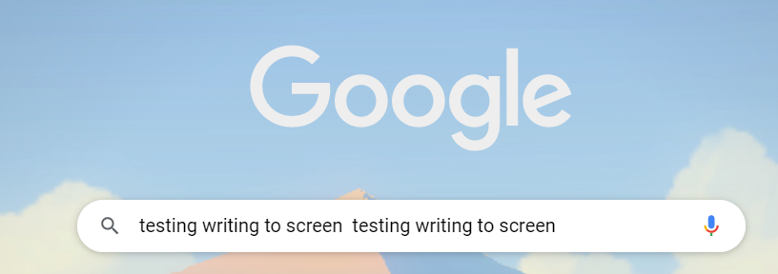
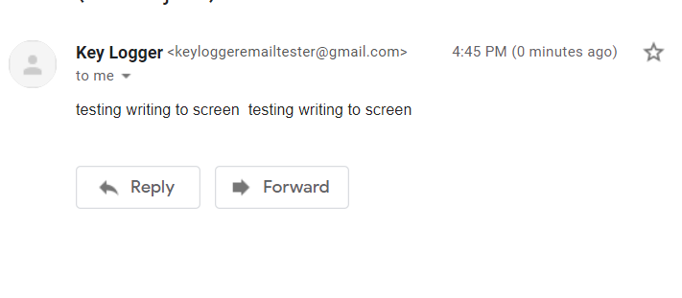

Slide 9
Challenges
Getting the keylogger to send emails to the gmail account
1
Gmail has extra security measures that had to be disabled
Getting the Program to capture screen shots of the user's screen
2

Slide 10
Keylogger Prevention : Detection
Hardware
- Check for any unknown item plugged into your computer (cords, USB drives)
Software
- Slower computer performance when browsing/starting programs
- Abnormal delays in activity
- Pop-ups
- New desktop icons
- Excessive hard drive and network activity

Slide 11
Keylogger Prevention : Protection
Do not open attachments or download files from unknown sources
Watch out for phishing scams
Two-factor authentication
Anti-spyware programs (for software keyloggers)
Use a password manager
When logging into important websites use a virtual keyboard
Notes:
Important websites are like banking websites

Slide 12
Questions?
Resources used:
//List of resources
Pynput library: https://github.com/moses-palmer/pynput

